Slide 1
33b – Clean Code – Memento and Extension Object Patterns
Based on the CleanCoders videos by Uncle Bob Martin
Rupert Waldron

Slide 2

Memento Pattern
The Memento pattern capture and externalize an object’s internal state so that the object can be restored to this state later. All without violating encapsulation. Great for undoing state.
The memento pattern is used when some object surrenders a private record of its internal state to some other part of the system. The system may hold onto that record for a time and may hand it back to the originating object which can re-generate itself from the recorded state. Alternatively, the system my create a new object from the recorded state, in any case, the recorded state remains private to the originating class. E.g. Undo is a good example for the use of the memento patterns.

Slide 3
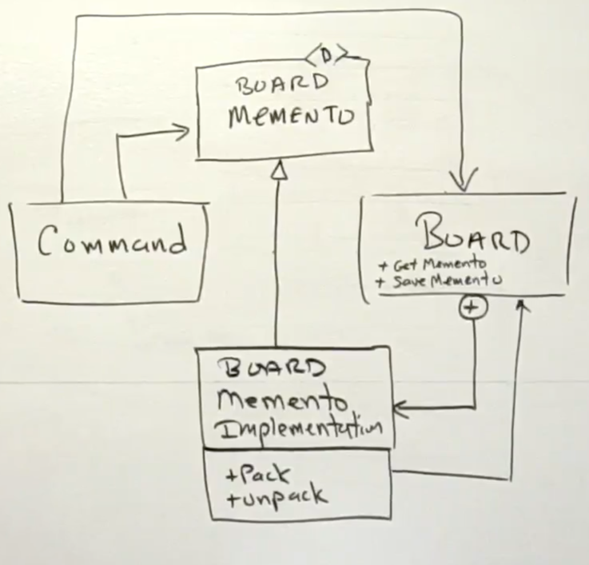
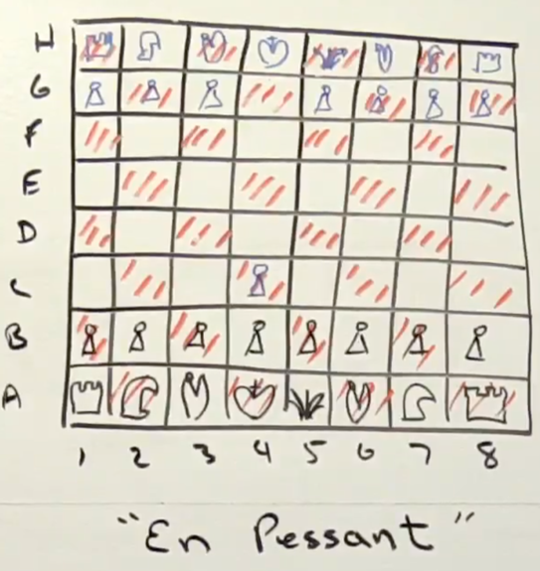
Memento Pattern – Chess Board Example
The Board is the only class that knows how to use the memento. The Command object can ask the board for the memento. The command object can hold on to the memento for as long as is necessary and then can return the memento to the board, but only the board can act on the memento. The rest of the system the memento is opaque with no methods that it can use.

Slide 4
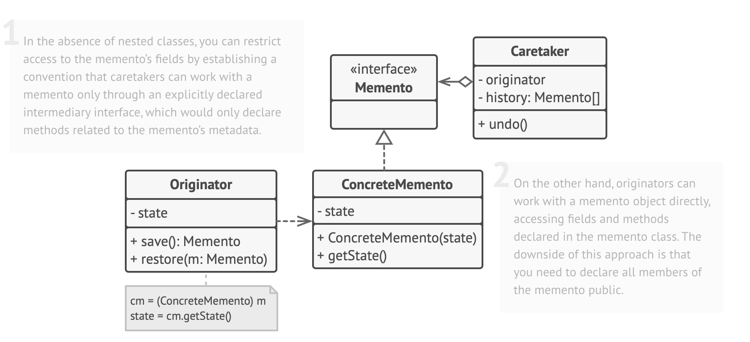
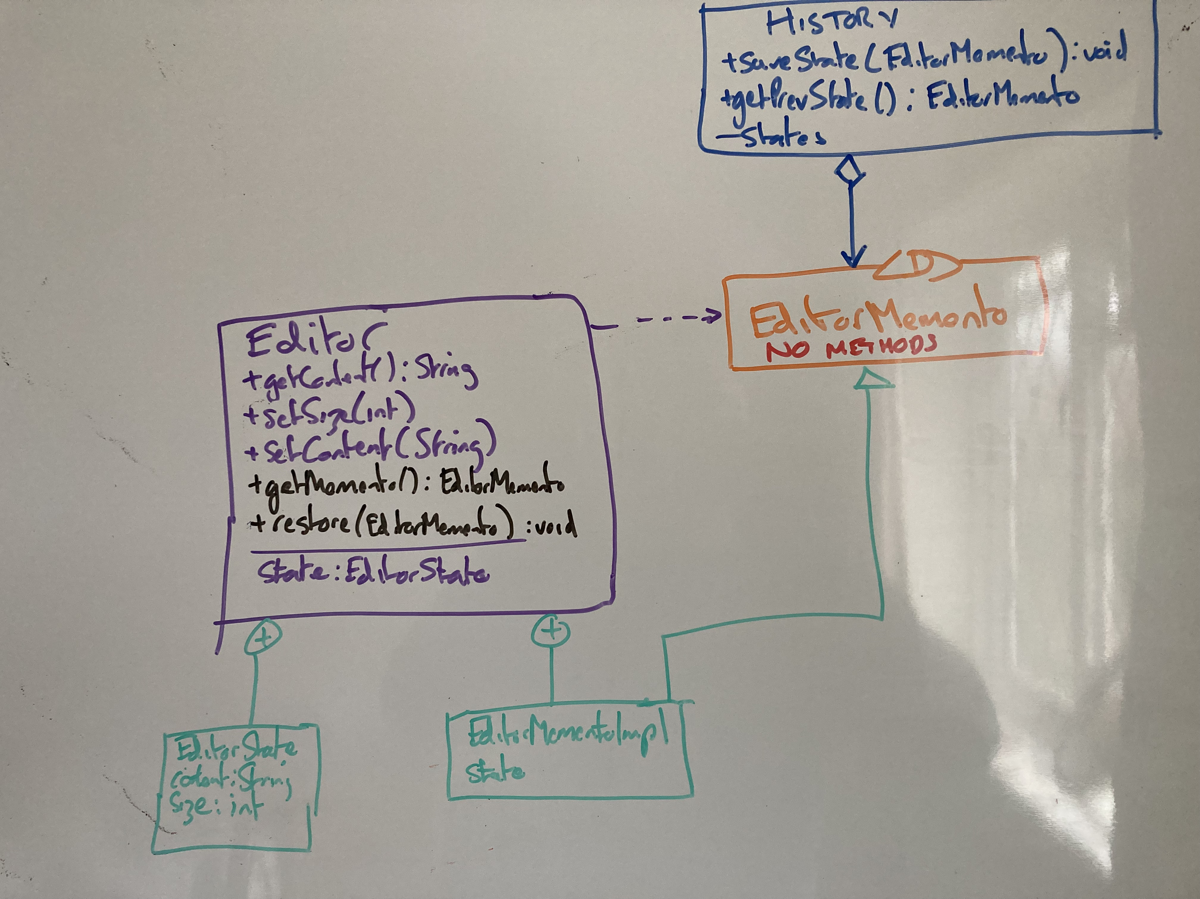
Memento Pattern – Editor Example
EditorMemento is a degenerative interface (no methods) so classes such as History can hold it but can’t invoke any methods on the object. The editor class is the only class that can use the EditorMemento and that is by casting it to an EditorMementoImpl which is a private inner Record of Editor. Show me the code…

Slide 5
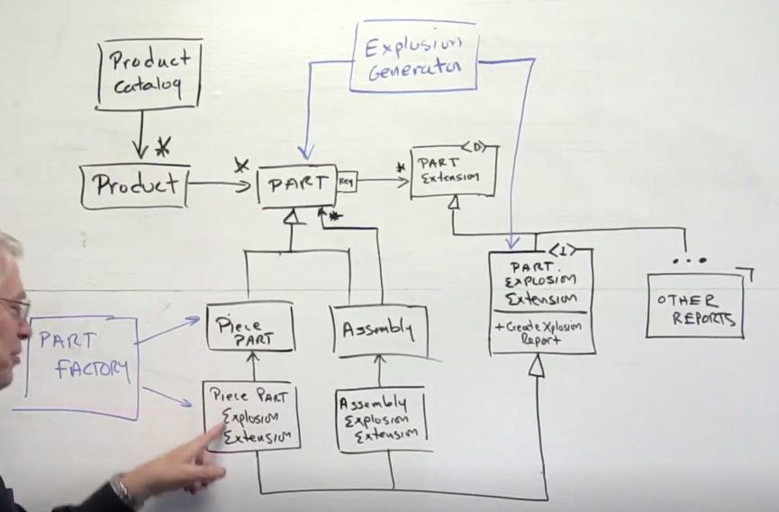
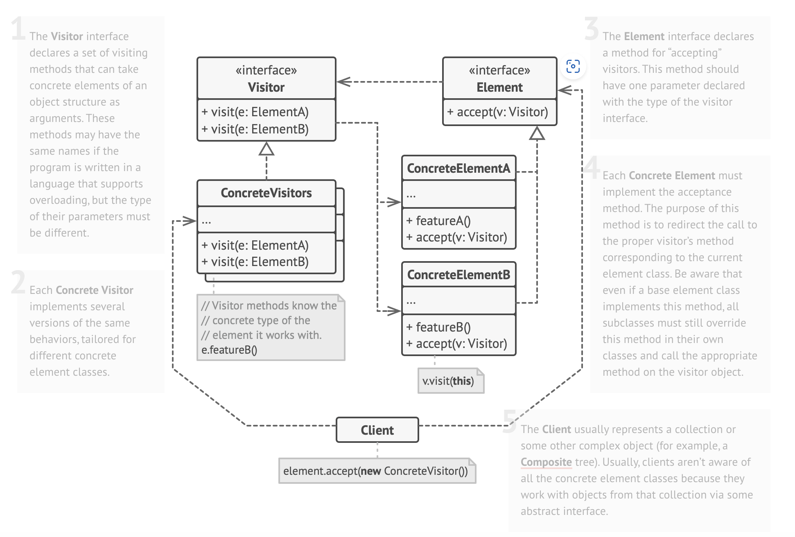
Extension Object Pattern
The Extension Object pattern adds functionality to the existing hierarchy just like the Visitor Pattern but is more flexible

